Slide 1
Cannabis Use
Melissa Goede
DATA 211
Spring 2024
Final

Slide 2
How much money do I spend on my daily cannabis use?
An ounce used to last me a week, now it lasts me four days.

Slide 3
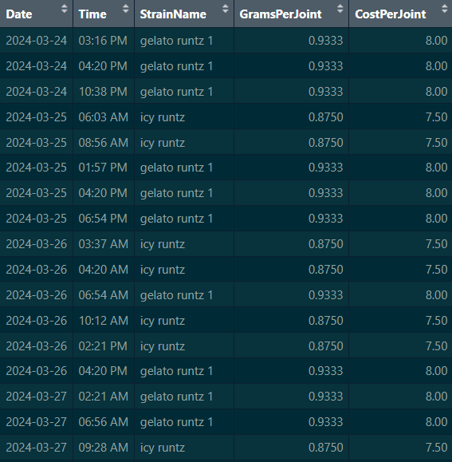

DATA 97 observations Variables:
Strain Name
Occurrence per strain
Grams Per Joint
Strain weight divided by number of occurrences
Cost Per Joint
$8.57 a gram when considering an ounce at $240
image source: dankstop.com

Slide 4
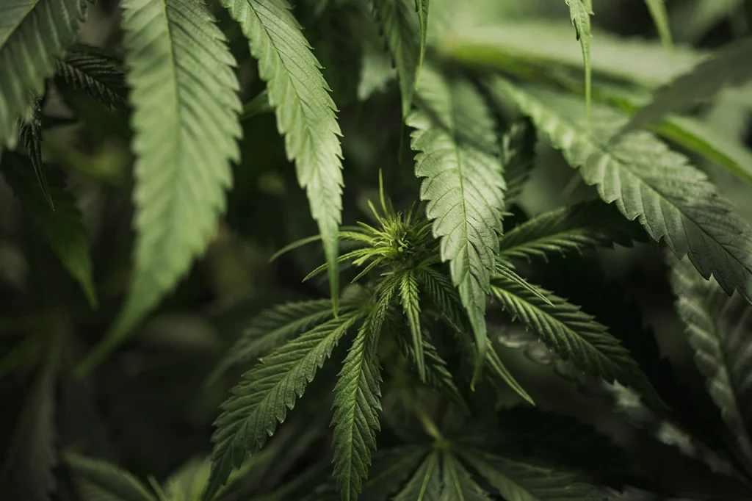
Hypothesis Testing
Claim:
My average daily cost is more than $60.
Variables:
Date
Cost Per Joint

Slide 5

Hypothesis Testing (cont.)
Step 1
Null Hypothesis
$H_{0}:μ=60$
Alternative Hypothesis
$H_{a}:μ>60$
Step 2
Use a one sample t-test
March 24 was removed from the data used as it included incomplete data

Slide 6
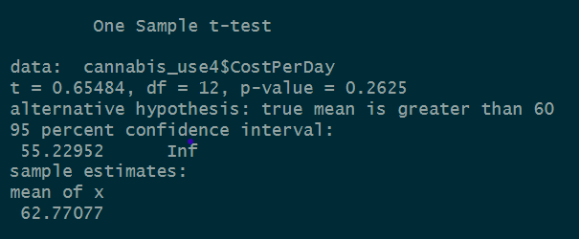
Hypothesis Testing (cont.)
Step 3
Test statistics
T = 0.65484
P-value = 0.2625
Step 4
Using a significance level of 0.05, fail to reject the null hypothesis

Slide 7
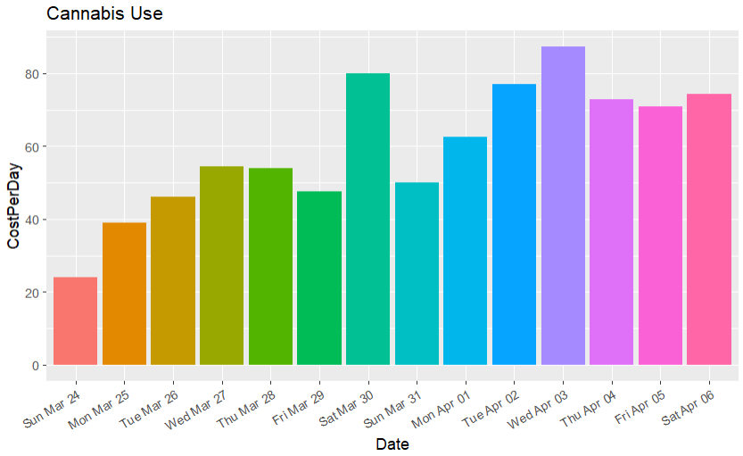
Conclusion
The p-value, 0.2625, is greater than 0.05, so it would fail to reject the null hypothesis. There is no evidence to support that my daily cost is significantly greater than $60.
https://github.com/melissa-goede001/school-project

